Slide 1

Mthree Final Project: Mixer
By Jobe Powell

Slide 2







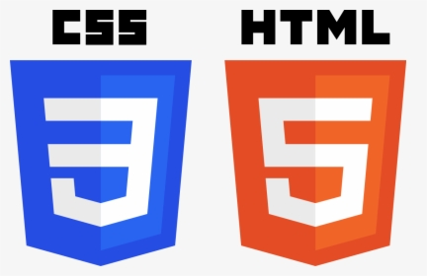
Mixer: the ultimate cocktail resource
A web service that assists user’s in accessing info related to creating cocktails
Technologies used: Java, MySql, Thymeleaf, jUnit, RestTemplate, SpringBoot MVC, HTML, CSS, TheCocktailDB API, Maven, JDBC Template

Slide 3
DEMO TIME!!!

Slide 4
Future Improvements
Add a recently viewed table to the db and to the homepage
Ability to save generated recipes

Slide 5
Q/A Time!!!

